Slide 1

FUEL PRICING MEDIA WORKSHOP
30 AUGUST 2012
Robert Maake, Hein Baak and Mashudu Sinthumule

Slide 2

Presentation Outline
Introduction
Policy position and key pricing mechanisms
BFP – The Basic Fuel Price for liquid fuels
MRGP – The Maximum Refinery Gate Price for liquefied petroleum gas (LPG)
SMNRP – The Single Maximum National Retail Price of illuminating paraffin (IP)
Frequently asked questions
Closure

Slide 3
Introduction
Three basic forms of fuel pricing globally
Ad hoc pricing - Prices set irregularly, No transparency – common in countries that have own oil (highly subsidised)
{It is an illusion – keeping the prices constant even when the markets are bullish, hoping that the prices will go down e.g. Bolivia.}
Formula based / automatic pricing adjustments – Prices are published (but not the formulas in some countries) e.g. RSA publish both prices and the formula
Liberalised pricing system – the market set the prices (depoliticised) but there is a formula e.g. Australia.
{The Australian Competition and Consumer Commission (ACCC) act as a watchdog to ensure that there is no price collusion}

Slide 4
Policy Position
Regulation of liquid fuels prices
Petrol, diesel and illuminating paraffin (IP) – retail prices
LPG for households since 14 July 2010
Import parity principle (IPP) applies
Dfn: The price an importer has to pay to purchase a product in the world market and have it delivered for domestic sale.
Deemed pricing
Zonal pricing – magisterial district zones (MDZ)
Transport modes – based on least cost mode
Cost recovery - Pass through cost

Slide 5
Regulatory / Policy Instruments
Energy White Paper on Energy Policy of November 1998
Petroleum Products Act, 1977 (Act No.120 of 1977);
Central Energy Fund Act, 1977 (Act No. 38 of 1977);
Gas Act, 2001 (Act No. 48 of 2001);
Petroleum Pipelines Act, 2003 (Act No.60 of 2003);
Gas Regulator Levies Act, 2002 (Act No. 75 of 2002);
Petroleum Pipelines Levies Act, 2004 (Act No. 28 of 2004);
National Energy Regulator Act, 2004 (Act No. 40 of 2004); and
National Energy Act, 2008 (Act No. 34 of 2008)

Slide 6
BASIC FUEL PRICE (BFP)

Slide 7
Definition
The Basic Fuel Price (BFP) is based on the import parity pricing principle i.e. what is would cost a South African importer of petrol to buy the petrol from an international refinery, transport the product from that refinery, insure the product against losses at sea and land the product on South African shores.
NB: The Central Energy Fund (CEF) (Pty) Ltd was appointed by Cabinet in 1994 as an impartial body to determine BFP’s (prevent manipulation by any interested party)
Daily and average monthly BFP’s for price regulated fuels are calculated by (CEF) in terms of the Working Rules to administer the BFP
Monthly BFP calculations, price changes to be effected and monthly Fuel Price Media Statement audited by independent auditors appointed by the DOE

Slide 8
BFP WORKING RULES
Make provision for all grades of petrol, all grades of diesel and illuminating paraffin (IP)
BFP to be adjusted on the first Wednesday of a month
Over/under recoveries incurred in a fuel price review period will be cleared in the next one
Important months
April – transport tariffs, fuel levy and RAF adjustments
September – Forecourts attendants wage adjustments
October – wholesale and retail margins adjustments including secondary storage and transport
Quarterly – Octane differential adjustments

Slide 9
ELEMENTS OF THE BFP
Free-on-Board (FOB)-value
Freight and Average Freight Rate Asses
Insurance
Ocean loss
Demurrage
Cargo Dues
Coastal Storage
Stock Financing costs

Slide 10
Free-on-Board [FOB] value (spot prices)
Platts: A price reporting agency. Mean quoted FOB-values used
Petrol: 50% MED (USD/ton)+50% Singapore (USD/bbl)
Diesel: 50% MED (USD/ton)+50% AG (USD/bbl)
IP: 50% MED (USD/ton)+50% Singapore (USD/bbl)
NB: Argus and Bloomberg are other agencies.

Slide 11
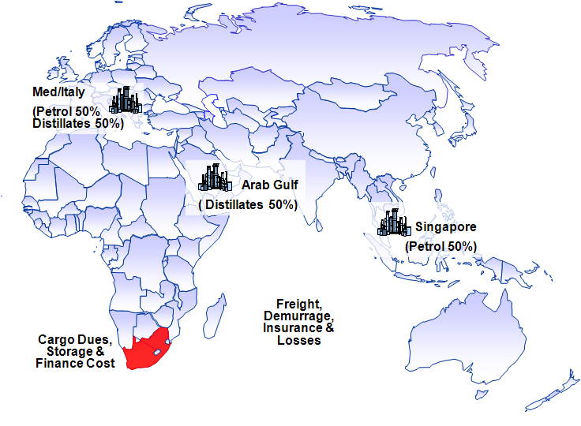
Different reference markets are used to determine the Basic Fuel Price (BFP) for petrol, diesel and IP

Slide 12
FREIGHT
London Tanker Brokers Panel
MR Vessel: 35,000 to 39,999 tons
Average of 37,499.5 tons used in calculation
Freight costs:
Petrol: 50% Med+50% Singapore
Diesel: 50% Singapore+50% AG
IP: 50% MED+50% AG
NB: 15% premium to supply RSA

Slide 13
INSURANCE, OCEAN LOSS AND CARGO DUES
Insurance=0.15% of (FOB-value+ Freight)
CIF-value=[Costs(FOB)+Insurance]+Freight
Ocean Loss= 0.3% of CIF-value
Cargo dues= Tariff set by the National Ports Authority

Slide 14
DEMURRAGE
Demurrage is the time spent in a harbour to load and discharge a cargo - hourly rent of vessel, but not operating
Demurrage rate: World Freight Rate Association
Rate for petrol:50%MED+50% Singapore
Rate for diesel and IP: 50% Singapore+50% AG
Days allowed: 3 days in total

Slide 15
COASTAL STORAGE
2002: Assessed at $3/bbl or 2.5 SA c/l per month
25 days allowed for storage =2.038 SA c/l
Adjusted annually in line with the movement in the Producer Price Index (PPI)
{CS=PPIn/PPIb*2.083 c/l}

Slide 16
STOCK FINANCING COST
25 days of stock-holding
Interest rate: Standard Bank’s prime interest rate less 2%
SFC= [LCV*(PR-2)*25/365]
LCV: Landed Cost Value
PR: Prime Interest Rate

Slide 17
BFP COMPOSITION OF 95 ULP IN AUGUST 2012 PRICES: 620.663 c/l
Average exchange rate: USD1=R8.2657
Average FOB: 587.146 c/l
Freight rate and AFRA: 21.002 c/l
Demurrage: 0.632 c/l
Insurance: 0.913 c/l
Ocean Leakage: 1.829 c/l
Cargo dues: 2.648 c/l
Coastal Storage: 3.603 c/l
Stock financing costs: 2.890 c/l
International conversion factors used

Slide 18
WHAT FACTORS INFLUENCE THE MAGNITUDE OF THE BFP?
International crude oil prices
International product supply/demand balances
Product inventory levels
Geo-politics
Value of the Rand/US Dollar exchange rate
International refining margins
Weather patterns in the Northern Hemisphere
NB: go to CEF website: cefgroup.co.za

Slide 19
FUEL LEVIES (1)
Incremental Inland Transport Recovery levy: to finance incremental inland transport costs due to the 100% capacity utilisation of the Durban/Johannesburg petroleum products pipeline
Petroleum products levy: to reimburse the pipeline users for the applicable NERSA tariff on transporting fuel through the pipeline - levy set by the Ministers of Energy and of Finance in line with the expenditure budget of NERSA
IP Tracer dye levy: to reimburse the oil industry for buying IP tracer dye and to inject it into IP to curtail the mixing of IP and diesel (loss to the Fiscus)
Slate levy: to finance the cumulative under recovery of the industry. Only applicable when the cumulative Slate balance exceeds R250 million (under recovery)

Slide 20
FUEL LEVIES (2)
Fuel levy: Tax levied by Government (Minister of Finance)
Custom and Exercise levy: a duty collected in terms of the Customs Union Agreement
Road Accident Fund (RAF) levy: To compensate for people involved in vehicle accidents.
Demand Side Management levy (DSML): Introduced in 2006 to curtail the use of ULP 95 in the inland market.

Slide 21
FUEL PRICE COMPOSITION

Slide 22
FUEL PRICE COMPOSITION
NB: DSML (ULP95 in GP), Petroleum products levy (0.15cpl)and IP Tracer Dye levy (0.01cpl) NOT included

Slide 23
SINGLE MAXIMUM NATIONAL RETAIL PRICE FOR PARAFFIN

Slide 24
COMPOSITION OF THE SMNRP FOR ILLUMINATING PARAFFIN (IP)
Price component | Cents per litre
Basic Fuels Price | 618.128
Wholesale margin | 54.085
Service differential | 11.400
Router differential | 7.400
Transport costs | 23.000
Sub-total | 714.013
Retail margin: (33,3% of 687.013) | 237.766
SMNRP (Linked to BFP) | 952.000 (rounded to full cents)
The maximum retail price at which "loose" Illuminating Paraffin, i.e. excluding cost of package/ packaging, may be sold at any place in South Africa is R971.0 per litre, in "own container" supplied for filling.

Slide 25
COMPOSITION OF THE SMNRP FOR ILLUMINATING PARAFFIN (IP)

Slide 26
MAXIMUM RETAIL PRICE FOR LPGAS

Slide 27
COMPOSITION OF THE MAXIMUM RETAIL PRICE FOR LPG
Maximum refinery gate price |  |  | 789.503 | 789.503
Primary transport costs |  |  | 37.120 | 175.960
Operating expenses |  |  | 343.000 | 343.000
Working capital |  |  | 26.000 | 26.000
Depreciation |  |  | 126.000 | 126.000
Gross margin: Cylinder-filling plant |  |  | 161.000 | 161.000
Sub-total (1) |  |  | 1 482.623 | 1 621.463
Retail Margin: (15% of Subtotal (1)) |  |  | 222.393 | 243.219
Sub-total (2) |  |  | 1 705.016 | 1 864.682
Value Added Tax (14% Sub-total (2)) |  |  | 238.702 | 261.056
Maximum Retail Price (Rounded to full cents) |  |  | 1 944.000 | 2 126.000
NB: Linked to petrol 93 octane

Slide 28
COMPOSITION OF THE MAXIMUM RETAIL PRICE FOR LPG

Slide 29
FREQUENTLY ASKED QUESTIONS
Why are the fuel prices changing every month?
What is over (under) recovery?
Why is petrol cheaper in neighboring countries and yet they purchase it from RSA?
Why is SASOL not selling petrol at lower prices because they produce it from coal and they are placed in GP?
Why is the government not deregulating fuel prices?
Why is ULP95 more expensive than ULP93 in GP, but the cost the same price in coastal areas?
Why is the government not buying oil from African countries at a lower prices?

Slide 30
QUESTIONS

